Slide 1
Data Analysis With the Help Of MS Excel
UPI Transactions IN India IN THE YEAR 2021
BY HIMANI SAKHARE [BTECH(EEE)]

Slide 2
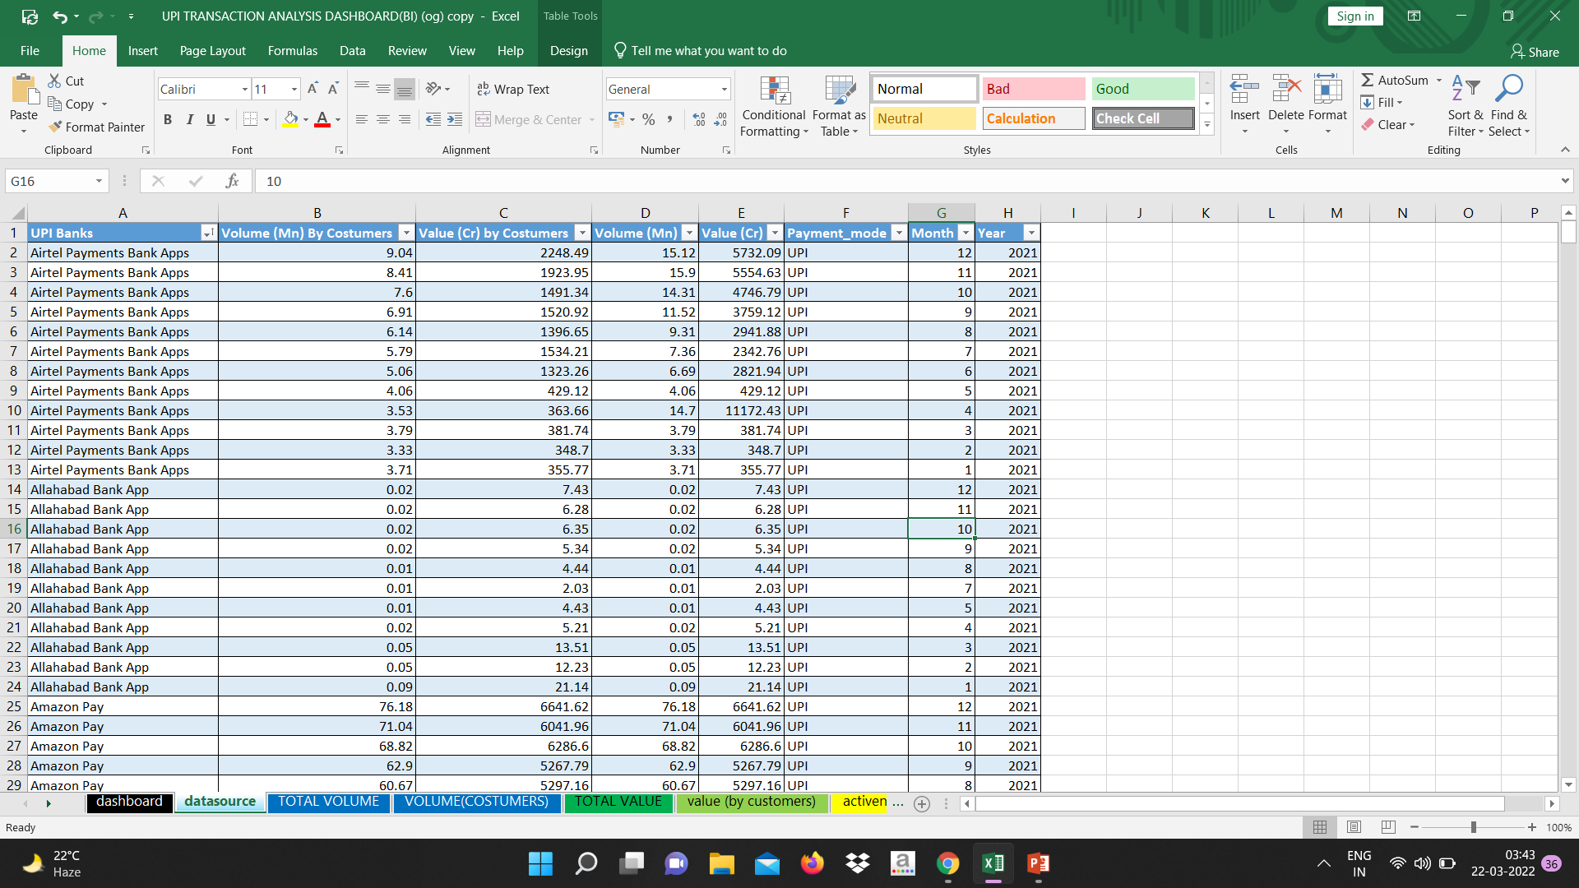
DETAILS ABOUT THE DATA SET
The dataset is about the UPI (unified payment interface) transaction of India in the year 2021.
Its consist of several bank’s applications, number of transactions with respect to their volume and valuation accordingly to the months and year.
Its consist of near about 7 columns and above 700 rows.
The dataset is taken from the Kaggle which is the online community of data scientists and machine learning practitioners.
The link of dataset is given below:
https://www.kaggle.com/code/upi-transactions-india-2021

Slide 3
PROBLEM STATMENTS
Monthly total volume (UPI transaction) in several bank’s application
Monthly volume (by costumers) in each banks.
Monthly total valuation of UPI transaction in each bank application.
Monthly total valuation of UPI transaction(by costumers) in each banks.
Which banks is been active through out the year.
Which top 5 banks app with respect to its volume of UPI transactions.
Which top 5 banks with respect to its valuation of UPI transactions.
Growth of UPI transaction in the year 2021.

Slide 4
MONTHLY TOTAL VOLUME OF UPI TRANSACTION IN SERVAL BANK’S APPLICATION.
This line chart indicates that how many UPI transactions happens with respect to its volume in various bank applications on monthly bases.
While analysing this we got to know about the phonepe is the highest application who is having the highest UPI transaction with respect to its volume and followed by the googlepay and the paytm .
From this we can find out which bank applications has how many UPI transaction with respect to its volume.

Slide 5
MONTHLY TOTAL VOLUME(BY COSTUMER) OF UPI TRANSACTION IN SERVAL BANK’S APPLICATIONS
By costumer means here the transaction is happening within the same bank only.
This line chart indicates that how many UPI transactions happens with respect to its volume (by costumer)in various bank applications on monthly bases.
While analysing this we got to know about the phonepe is the highest application who is having the highest UPI transaction with respect to its volume(by costumer)and followed by the googlepay and the paytm .
One insight we got to know here the airtel payment is one application which is having doubled in the ratio of the transaction with others banks.

Slide 6
Monthly total valuation of UPI transaction in each bank Application
This line chart indicates that how much UPI transactions happens with respect to its valuation in various bank applications on monthly bases.
While analysing this we got to know about the phonepe is the highest application who is having the highest UPI transaction with respect to its valuation and followed by the googlepay and the paytm .
From this we can find out which bank applications has how many UPI transaction with respect to its valuation.

Slide 7
Monthly total valuation of UPI transaction(by costumers) in each banks.
By costumer means here the transaction is happening within the same bank only.
This line chart indicates that how many UPI transactions happens with respect to its valuation (by costumer)in various bank applications on monthly bases.
While analysing this we got to know about the phonepe is the highest application who is having the highest UPI transaction with respect to its valuation(by costumer)and followed by the googlepay and the paytm .

Slide 8
Which bank’s upi app and upi application is been active through out the year
This chart indicates the activeness of bank application in terms of performance by means of its volume and valuation.
So the insight we got know from this chart is that Andhar bank application is one who is the least one who is been active through the year 2021.
Goibibo , PSB, Truecaller, Whatsapp and J&K bank are the UPI applications who are lowest activeness through out the year as compare to other applications.
From this we can find out the status of UPI applications in terms of activeness through out the year.

Slide 9
Which top 5 banks app with respect to its volume of UPI transactions.
This pie chart indicates top 5 bank’s app with respect to its total volume of UPI transactions.
Phonepe, Googlepay, Paytm payment bank App, amazon pay, axis bank Apps are the top 5 application with respect to its volume of upi transaction.

Slide 10
Which top 5 bank’s app with respect to its valuation of UPI transactions
This pie chart indicates top 5 bank’s app with respect to its total valuation of UPI transactions.
Phonepe, googlepay,paytm ,Cred, Bhim are the top 5 application with respect to its valuation of upi transaction.
You can see the difference in terms of volume top 5 application are different and in terms of valuations, few of them are different.

Slide 11
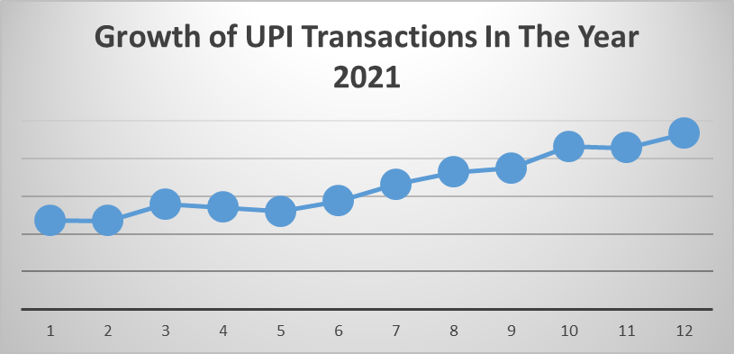
Growth of UPI transaction in the year 2021.
This chart clearly indicates that growth of UPI transaction is been increasing only .

Slide 12
conclusion
UPI is undoubtly one of the fastest growing mode of payment in India.
I tried to summarized my knowledge to extract information out of provided data.

Slide 13
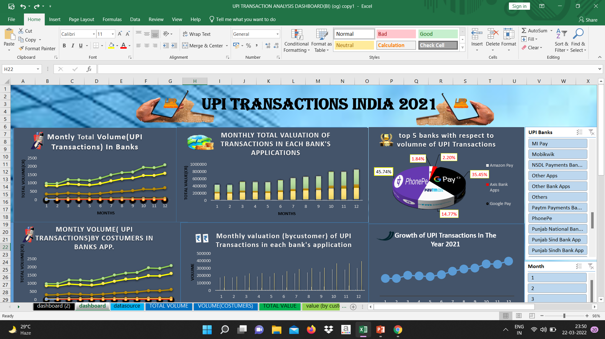

Slide 14
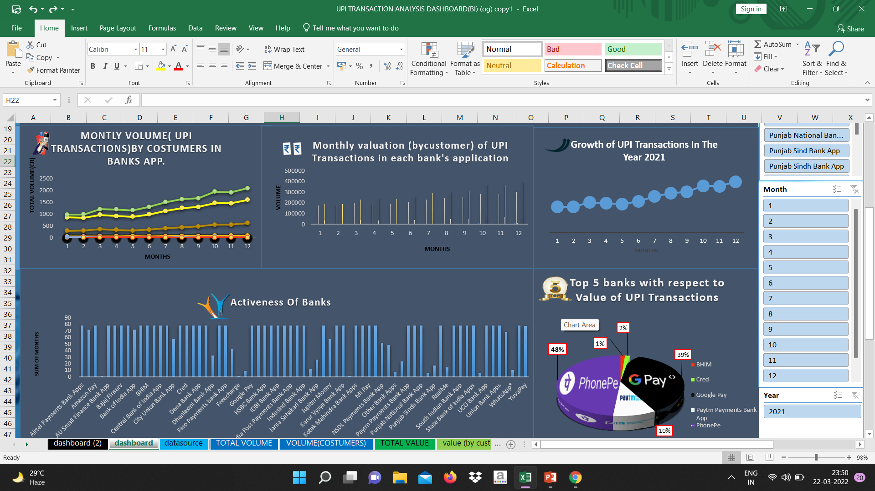

Slide 15
Drive link where all the files are been uploaded
https://drive.google.com/drive/folders/1wlHHrX0sAjd3yOtx0E5HIXXYF-QK8x3P?usp=sharing

Slide 16
thank you

